Slide 1
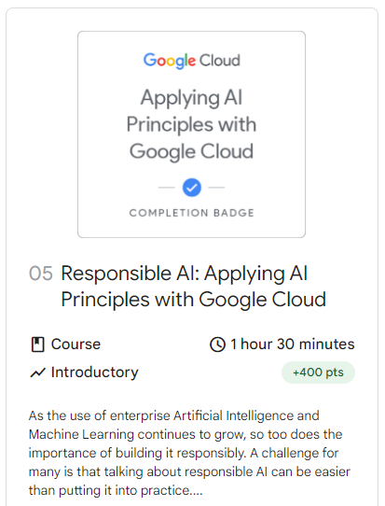

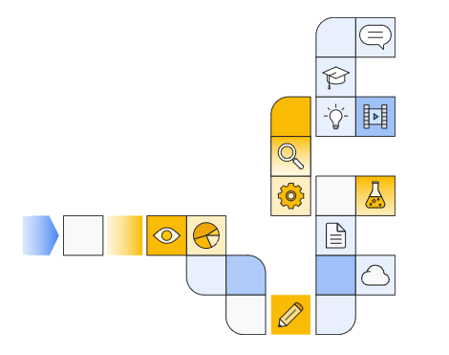
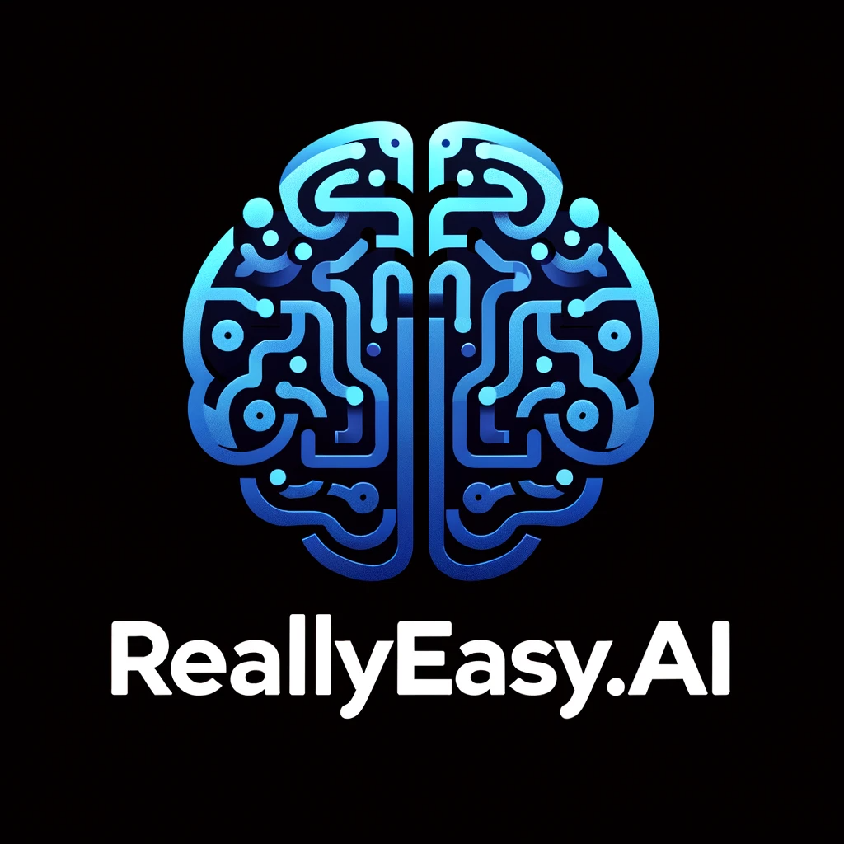
Notes:
https://www.cloudskillsboost.google/paths/118/course_templates/388

Slide 2
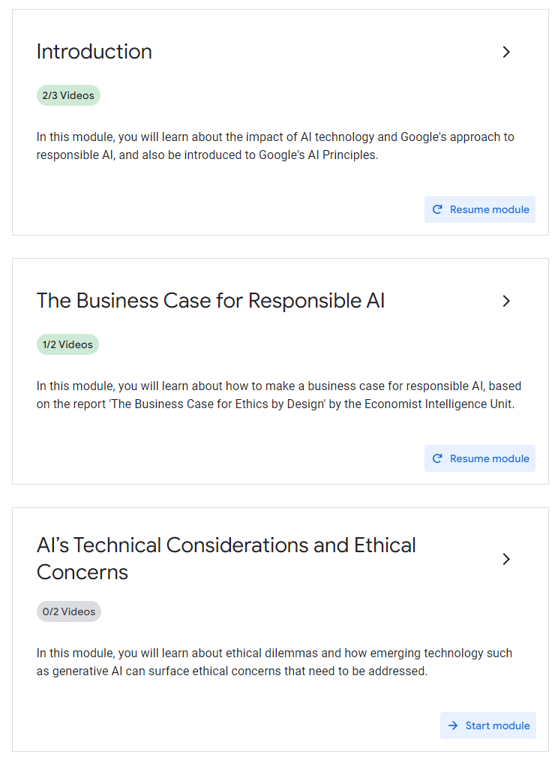
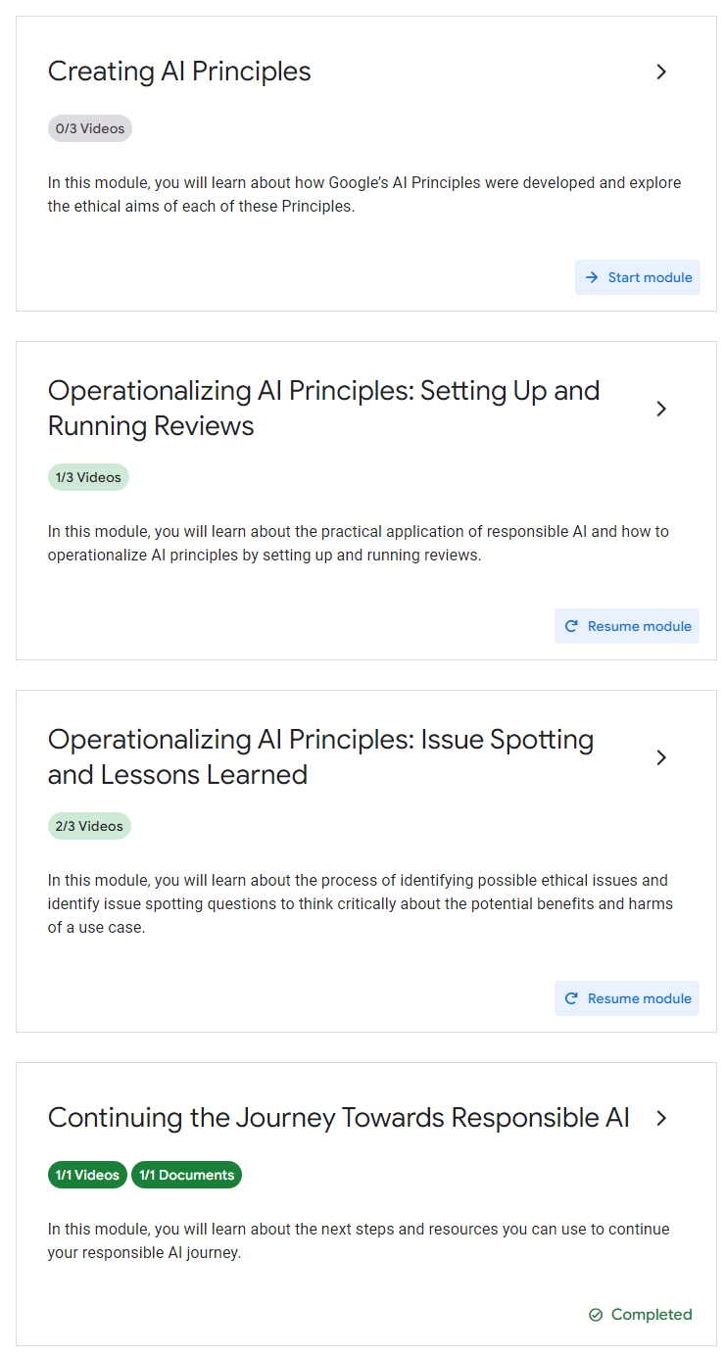

Slide 3
Course Introduction

Slide 4
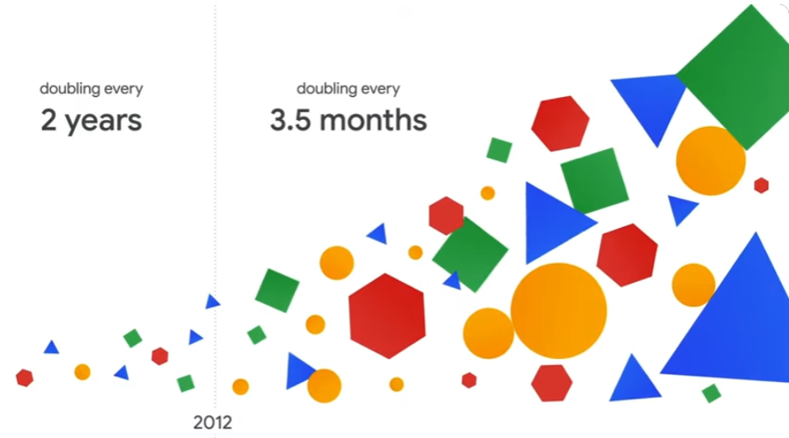

Slide 5
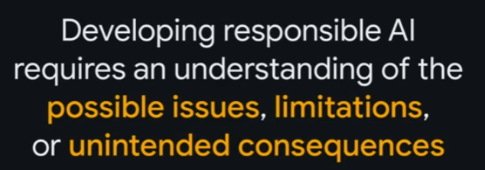

Slide 6
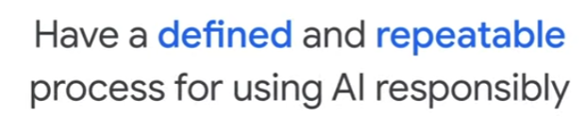

Slide 7
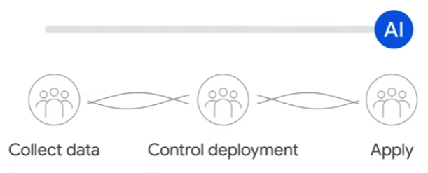
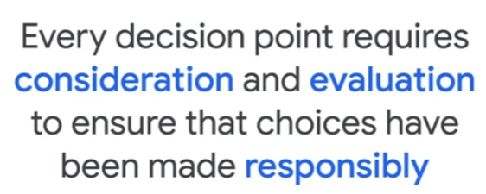

Slide 8
Google & Responsible AI

Slide 9
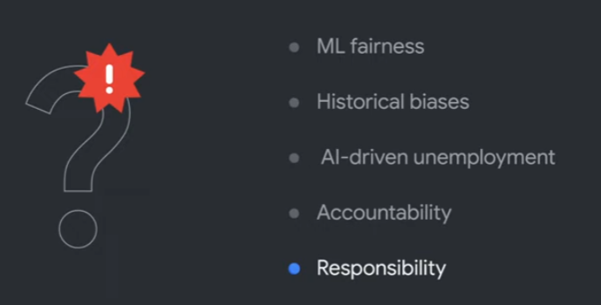

Slide 10
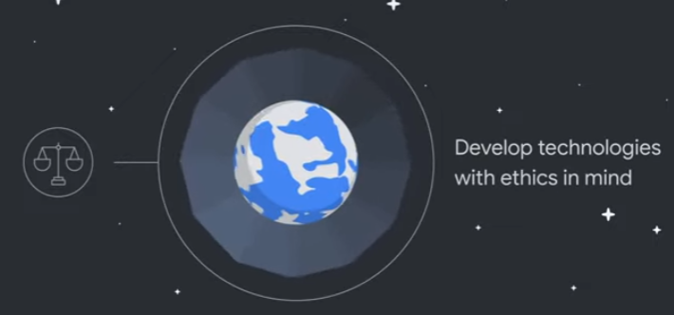

Slide 11
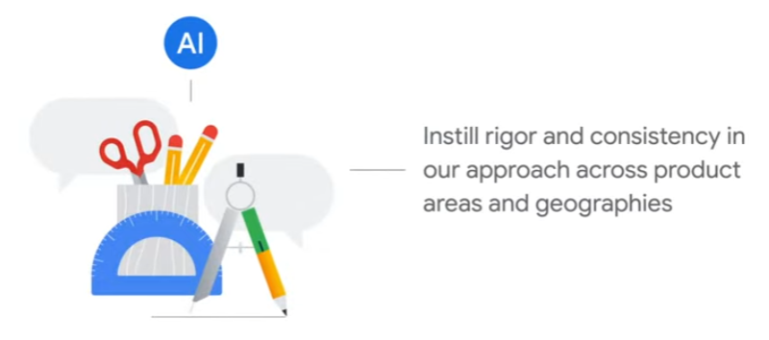

Slide 12
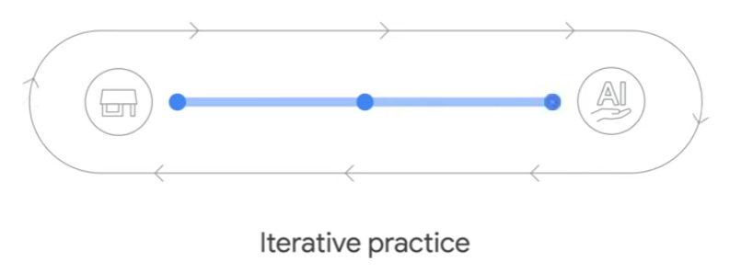

Slide 13
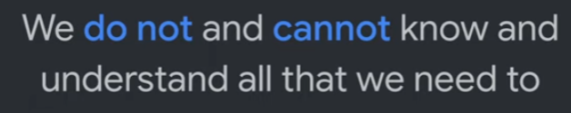
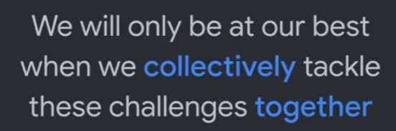

Slide 14
Introduction to Google's ai principals

Slide 15
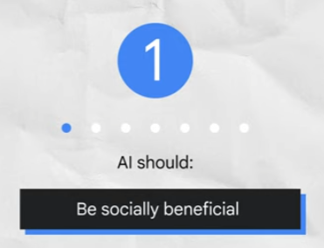
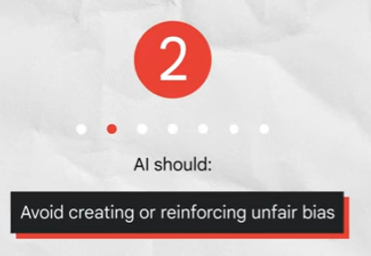
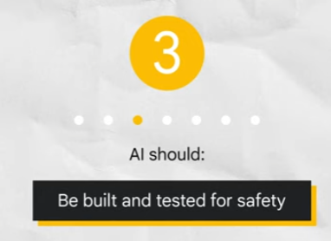
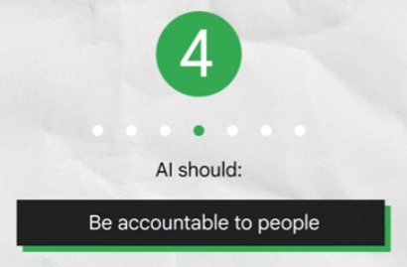
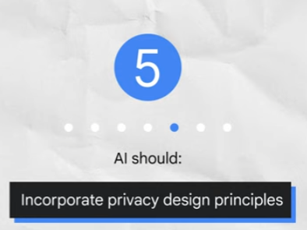
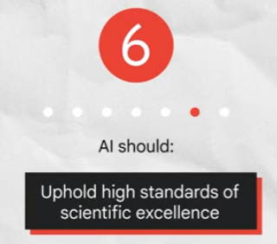
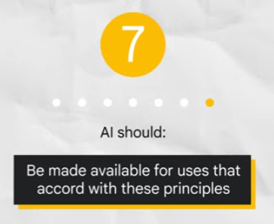

Slide 16
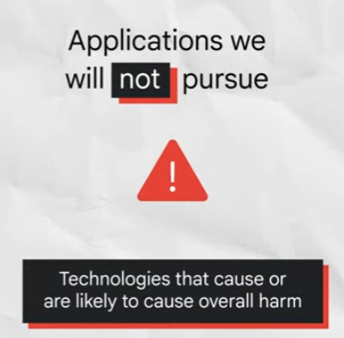
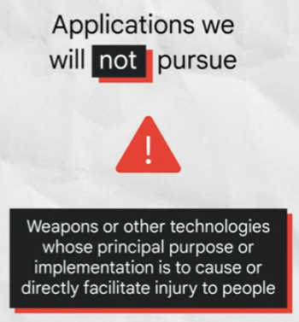

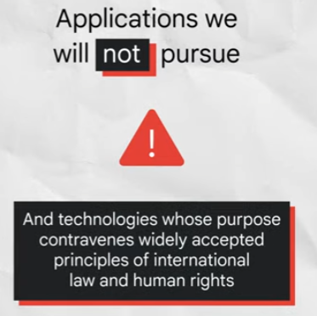

Slide 17
The economist intelligence unit report
Notes:
https://www.eiu.com/n/staying-ahead-of-the-curve-the-business-case-for-responsible-ai/

Slide 18
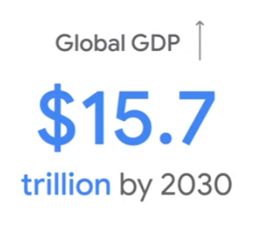
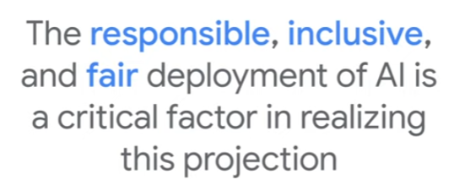

Slide 19
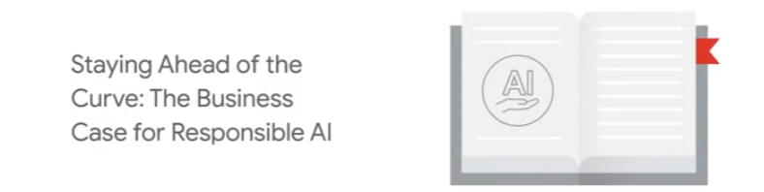

Slide 20
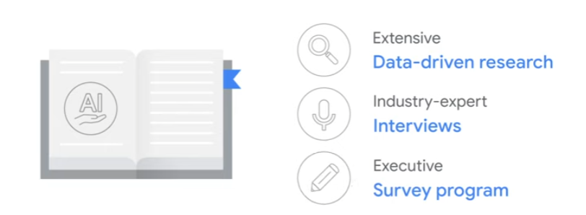

Slide 21
The business Case for Responsible Innovation

Slide 22
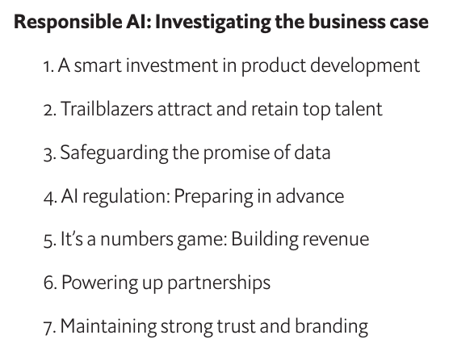

Slide 23
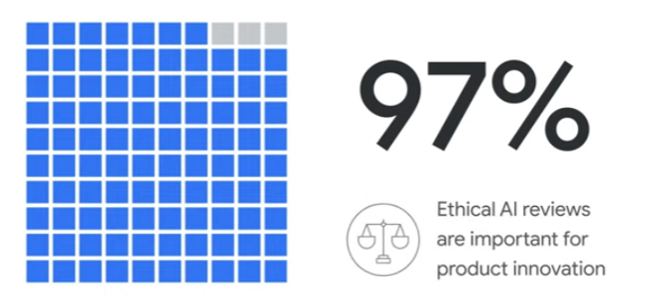

Slide 24
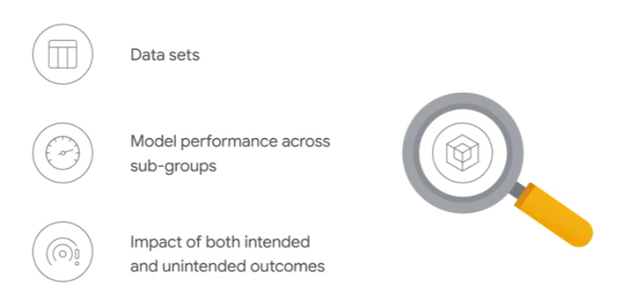

Slide 25
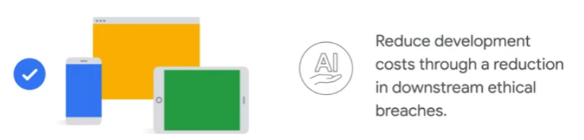

Slide 26
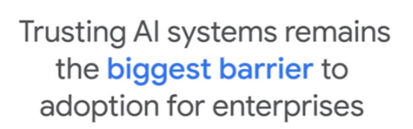
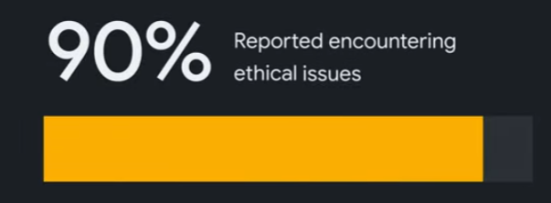
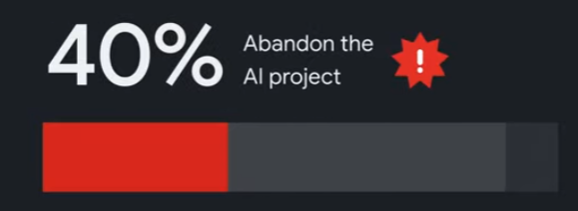

Slide 27
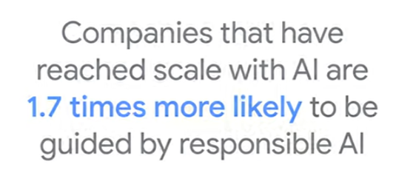
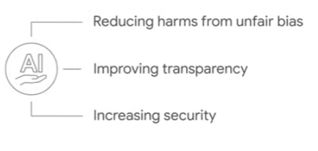

Slide 29
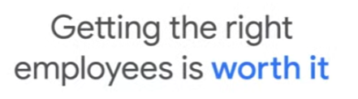

Slide 30
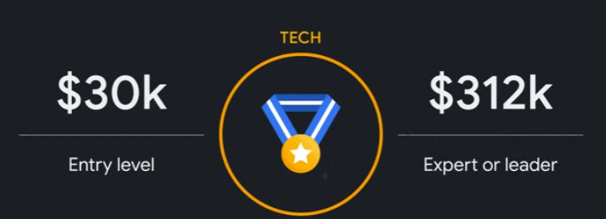

Slide 31
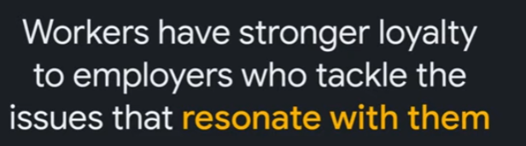

Slide 33
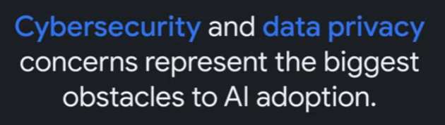

Slide 34
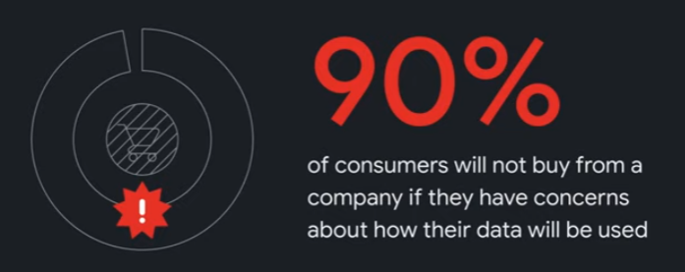

Slide 35
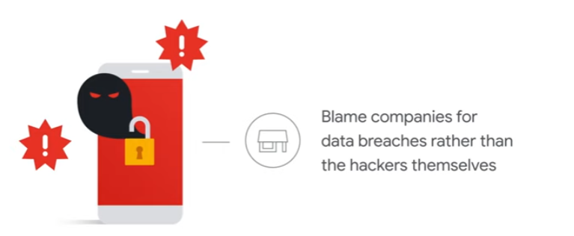

Slide 36
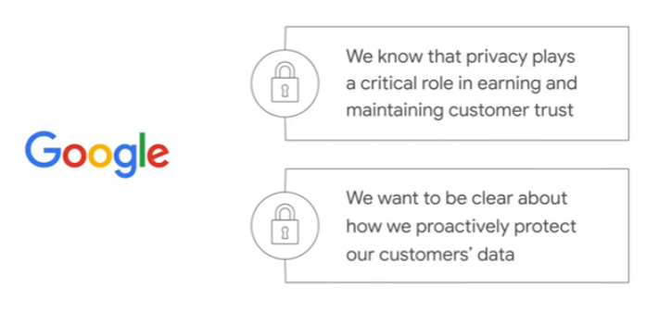

Slide 37
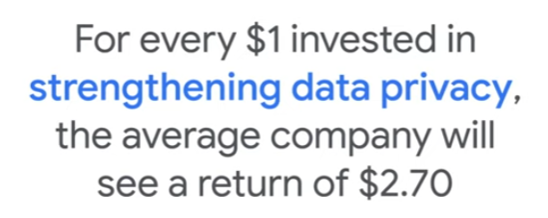

Slide 38
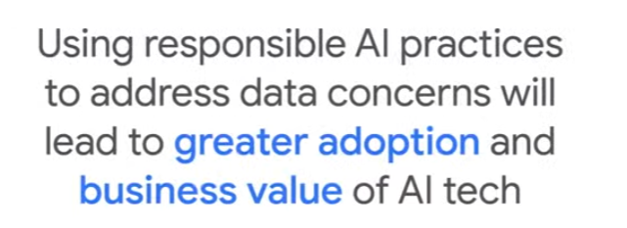

Slide 40
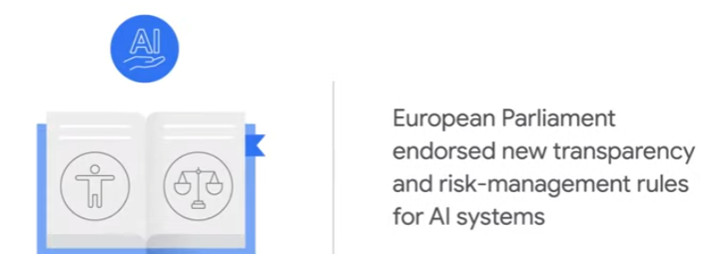

Slide 41
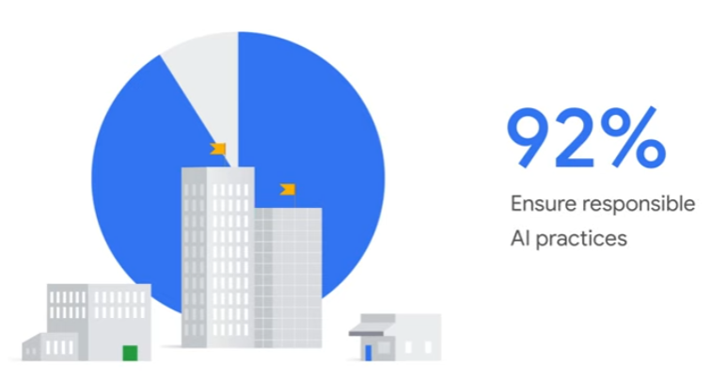

Slide 42


Slide 43


Slide 44


Slide 45


Slide 47


Slide 48



Slide 50




Slide 52


Slide 53


Slide 54
Ai’s technical Considerations and Ethical Concerns

Slide 55


Slide 56


Slide 57


Slide 58


Slide 59


Slide 60


Slide 61


Slide 62


Slide 63



Slide 64


Slide 65
Concerns about Artificial Intelligence

Slide 66


Slide 67


Slide 68



Slide 69


Slide 70


Slide 71


Slide 72


Slide 73


Slide 74


Slide 75


Slide 76


Slide 77


Slide 78


Slide 79


Slide 80


Slide 81


Slide 82


Slide 83


Slide 84


Slide 85


Slide 86


Slide 87


Slide 88


Slide 89
How Google’s Ai Principals Were Developed

Slide 90


Slide 91


Slide 92


Slide 93



Slide 94


Slide 95


Slide 96


Slide 97


Slide 98


Slide 99
Ethical Issue Spotting

Slide 100
Issue spotting is the process of recognizing the potential for ethical concerns in an AI project.

Slide 101
It may be tempting to try and make this process more efficient through checklists, outlining what is and isn’t acceptable for each principle.
We know it’s tempting because we tried it.
We tried to create decision trees and checklists that would ensure our technology would be ethical.
That didn’t work.
We’ve learned that there’s no replacement for careful review of the facts of each case.

Slide 102


Slide 103


Slide 104


Slide 105


Slide 106
Ethical Aims of Google’s AI Principals

Slide 107


Slide 108


Slide 109


Slide 110


Slide 111


Slide 112


Slide 113




Slide 114


Slide 115


Slide 116


Slide 117


Slide 120


Slide 121
Setting up and Running Reviews

Slide 122


Slide 123



Slide 124


Slide 125


Slide 126


Slide 127


Slide 128


Slide 129


Slide 130


Slide 131
Google Cloud’s Review Process

Slide 132


Slide 133


Slide 134


Slide 135


Slide 136


Slide 137


Slide 138


Slide 139


Slide 140


Slide 141


Slide 142


Slide 143


Slide 144


Slide 145
Celebrity Recognition Case STudy

Slide 146


Slide 147
The Celebrity Recognition API is a pre-trained AI model — meaning it’s not customizable— that’s able to recognize thousands of popular actors and athletes from around the world based on licensed images.
This is Google Cloud’s first enterprise product with facial recognition.

Slide 148
Facial recognition was identified as a key concern for potential unfair bias.
In early 2016, Cloud leadership decided facial recognition would not be a part of the Cloud Vision API offering, despite it being a top request from our customers.

Slide 149


Slide 150


Slide 151


Slide 152
To reduce the potential for misuse and make the technology available for an enterprise use case aligned with our AI principles, Google decided to pursue a tightly scoped facial recognition application for celebrity recognition.
Google decided to pursue a tightly scoped facial recognition application for celebrity recognition.

Slide 153


Slide 154
Systemic underrepresentation of black and minoritized actors in society was a key factor in our evaluation given the product’s intended use.
To focus even further on potential impacts we engaged with an external human rights consultancy— called Business for Social Responsibility, or BSR— to conduct an in-depth Human Rights Impact Assessment.
https://www.bsr.org/en/blog/google-human-rights-impact-assessment-celebrity-recognition

Slide 155
Based on BSR’s recommendations Google implemented a number of safeguards, including:
Making the Celebrity Recognition API available only to qualifying customers behind an allow list.
The database of “Celebrity” individuals is carefully defined and restricted to a predefined list.
An opt-out policy is implemented to enable celebrities to remove themselves from the list.
And an expanded terms of service apply to the API.

Slide 156
A small subset of actors represented a significant proportion of the total missed identifications in the evaluation datasets Especially for darker-skinned men Knowing the majority of error rates were affecting a select few actors we looked at the actors with the largest number of errors and found they had nearly a 100% false rejection rate.
Due to the reduced scope of the Celebrity Recognition API we were able to go one by one through the test set and gallery to determine what the problem was.
We found that for three black actors our celebrity gallery had images of them as adults while the training set had images of them as much younger actors.
Our model could not recognize the adult actors as the younger characters they had played years prior.
In this instance, we were able to correct that problem by expanding the training dataset to
include images of celebrities at many different points in their careers and at different ages .
This removed the discrepancy between error rates.

Slide 157
Issue Spotting Process

Slide 158


Slide 159


Slide 160
Identifying the areas of risk and harm for use cases relevant to your business context is critical, and particular care should be taken when building AI applications in these areas.
These could, for example, be use cases involving Surveillance or Synthetic Media among many others.
Areas that are complex for your business will depend a lot on your domain customers.

Slide 161


Slide 162
The causes of ASD are deeply debated, though research indicates that its prevalence is increasing and that children diagnosed early and provided with key services are more likely to reach their fullest potential.
Some schools have found success with robots that help students practice verbal skills and social interactions under the supervision of a trained therapist, but this is not yet an affordable or widely accessible resource.
As a, result, not all schools provide such support.

Slide 163


Slide 164
From a social benefit standpoint, the aim of the product is to expand access to a form of therapy not currently available for all who could benefit from it.
However, is this the best or right way to offer this therapy and should ASD be treated as something that needs this type of intervention at all?
The goal of avoiding the creation or reinforcement of unfair bias may lead your team to ask: How might the team involved influence the fairness of the model?
Reviewing the product design and integration, where should fairness be closely considered and evaluated?
Do we have the necessary input from the people who will be directly affected by the Carebot?
Where will the training data be sourced to develop the underlying models for the Carebot?
Who will that data represent, and are there people, or groups of people, with ASD who may not be well represented?

Slide 165
Issue spotting Challenges

Slide 166


Slide 167


Slide 168
The metrics that indicate success for responsible innovation may look a bit different from traditional business metrics.
For example, we track issues and their related mitigations, and how they are implemented in the product.
We also look at the impact our AI governance has on building customer trust and accelerating deal success.
Another measure of effectiveness is gathering end -users' experiences and perceptions through surveys and customer feedback.
These types of metrics help to track impact, identify trends, and establish precedents.

Slide 169
When applying our principles, ethical dilemmas often arise rather than clear decisions between right and wrong.
Members of the review committee, each with their individual interpretation of the AI principles, lived experiences and expertise, apply their own values to ethical issues.
This can create a tension between different values that fosters a lot of debate.
It’s important to remember that these dilemmas, and resulting deliberations, are a core goal of an AI Principles review.

Slide 170


Slide 171
An additional challenge we face is getting direct input from external domain experts and affected groups.
This is critical, but not easy and we want to recognize that the process of doing so can be difficult.
No one person can represent the viewpoints of the group of people you are trying to represent.
The goal is to hear as wide a range of voices as possible so that products are made for everyone.

Slide 172
Best Practices

Slide 173


Slide 174


Slide 175


Slide 176


Slide 177


Slide 178


Slide 179


Slide 180


Slide 181


Slide 182
However, while exploring all potential issues is an important step in this process, in order to avoid analysis paralysis you must ground your issue spotting in technical, business and societal realities before developing a comprehensive set of guardrails.

Slide 183


Slide 184


Slide 185
Continuing the AI Journey

Slide 186
At Google, we believe that rigorous evaluations of how to build AI responsibly are not only the right thing to do, they are a critical component of creating successful AI.
Products and technology should work for everyone.
Our AI Principles keep us motivated by a common purpose, guide us to use advanced technologies in the best interest of people around the world, and help us make decisions that are aligned with Google's mission and core values.

Slide 187
Our challenge to you is that you now take this knowledge and develop your own AI principles and accompanying review process.
Wherever you are in your AI journey a valuable goal can be to talk with your teams about what responsible AI means in the context of your own business.
Those discussions can help you when outlining your own AI principles.

Slide 188

https://cloud.google.com/responsible-ai
responsibleai@google.com

Slide 189
Resources
https://ai.google/
https://blog.google/technology/ai/ai-principles/
https://blog.google/technology/ai/responsible-ai-principles/
https://pair.withgoogle.com/
https://ai.google/static/documents/building-a-responsible-regulatory-framework-for-ai.pdf

Slide 190


